Slide 1
C++ Programming:
From Problem Analysis to Program Design, Fourth Edition
Chapter 8: User-Defined Simple Data Types, Namespaces, and the string Type

Slide 2
Objectives
In this chapter, you will:
Learn how to create and manipulate your own simple data type—called the enumeration type
Become familiar with the typedef statement
Learn about the namespace mechanism
Explore the string data type, and learn how to use the various string functions to manipulate strings
C++ Programming: From Problem Analysis to Program Design, Fourth Edition
‹#›

Slide 3
Enumeration Type
Data type: a set of values together with a set of operations on those values
To define a new simple data type, called enumeration type, we need three things:
  A name for the data type
  A set of values for the data type
  A set of operations on the values
C++ Programming: From Problem Analysis to Program Design, Fourth Edition
‹#›

Slide 4

Enumeration Type (continued)
A new simple data type can be defined by specifying its name and the values, but not the operations
  The values must be identifiers
Syntax:
  value1, value2, … are identifiers called enumerators
  value1 < value2 < value3 <...
C++ Programming: From Problem Analysis to Program Design, Fourth Edition
‹#›

Slide 5
Enumeration Type (continued)
Enumeration type is an ordered set of values
If a value has been used in one enumeration type it can’t be used by another in same block
The same rules apply to enumeration types declared outside of any blocks
C++ Programming: From Problem Analysis to Program Design, Fourth Edition
‹#›

Slide 6
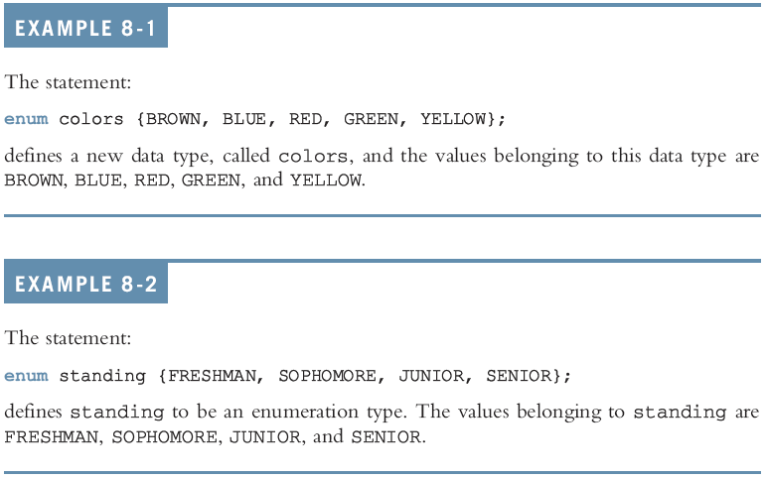
Enumeration Type (continued)
C++ Programming: From Problem Analysis to Program Design, Fourth Edition
‹#›

Slide 7
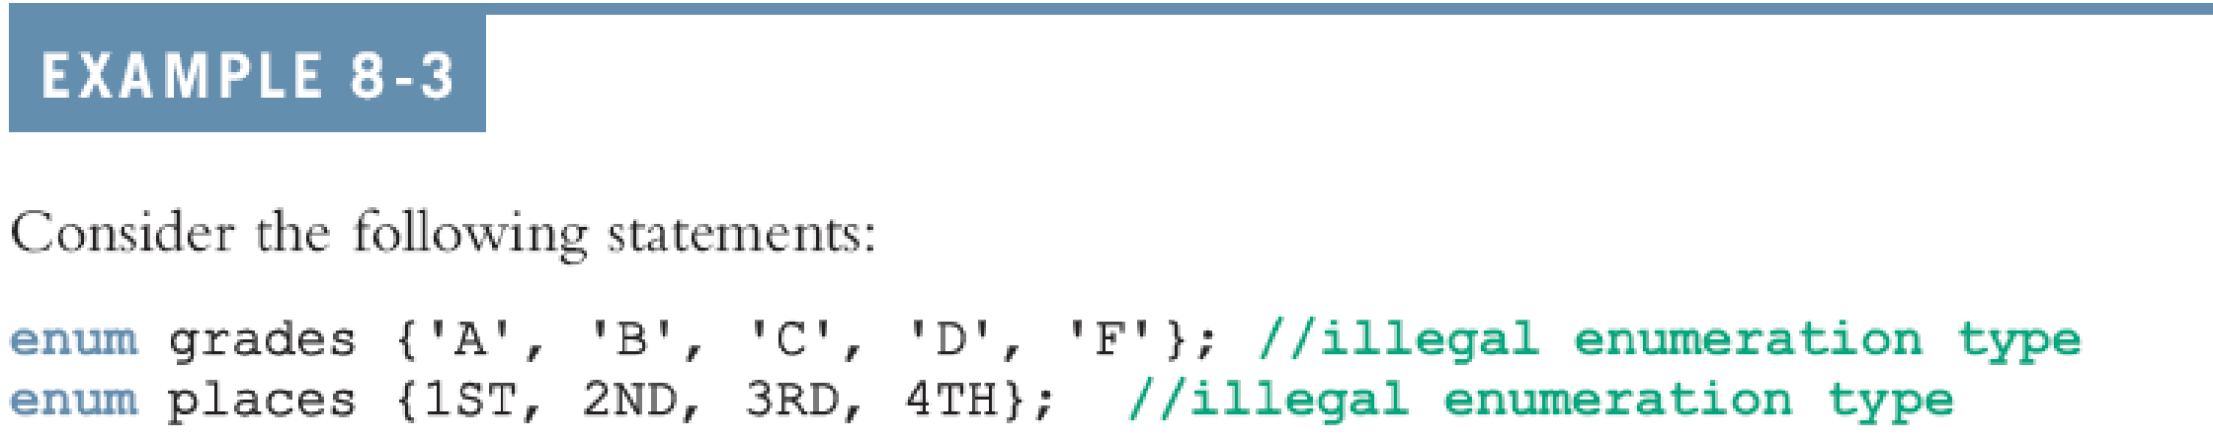
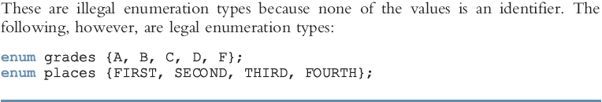
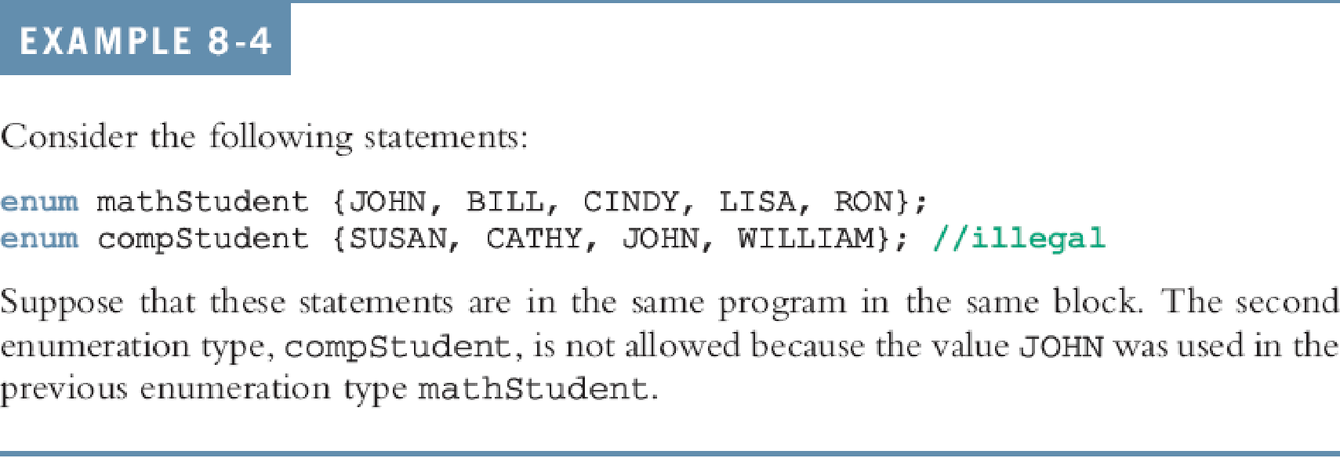

Slide 8

Declaring Variables
Syntax:
For example, given the following definition:
we can declare the following variables:
C++ Programming: From Problem Analysis to Program Design, Fourth Edition
‹#›

Slide 9
Assignment
The statement:
popularSport = FOOTBALL;
stores FOOTBALL into popularSport
The statement:
mySport = popularSport;
copies the value of the popularSport into mySport
C++ Programming: From Problem Analysis to Program Design, Fourth Edition
‹#›

Slide 10
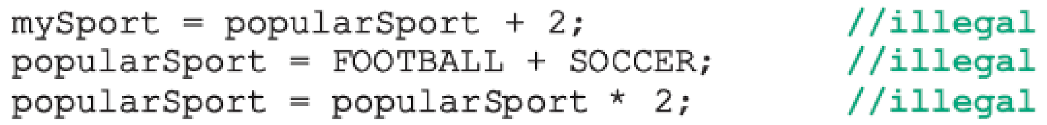

Operations on Enumeration Types
No arithmetic operations are allowed on enumeration types
++ and -- are illegal too:
Solution: use a static cast:
C++ Programming: From Problem Analysis to Program Design, Fourth Edition
‹#›

Slide 11
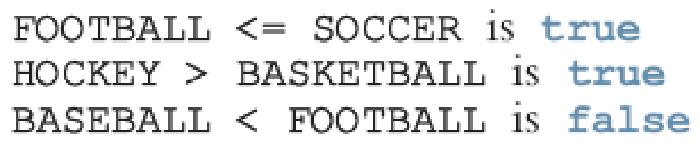
Relational Operators
An enumeration type is an ordered set of values:
Enumeration type is an integer data type and can be used in loops:
C++ Programming: From Problem Analysis to Program Design, Fourth Edition
‹#›

Slide 12
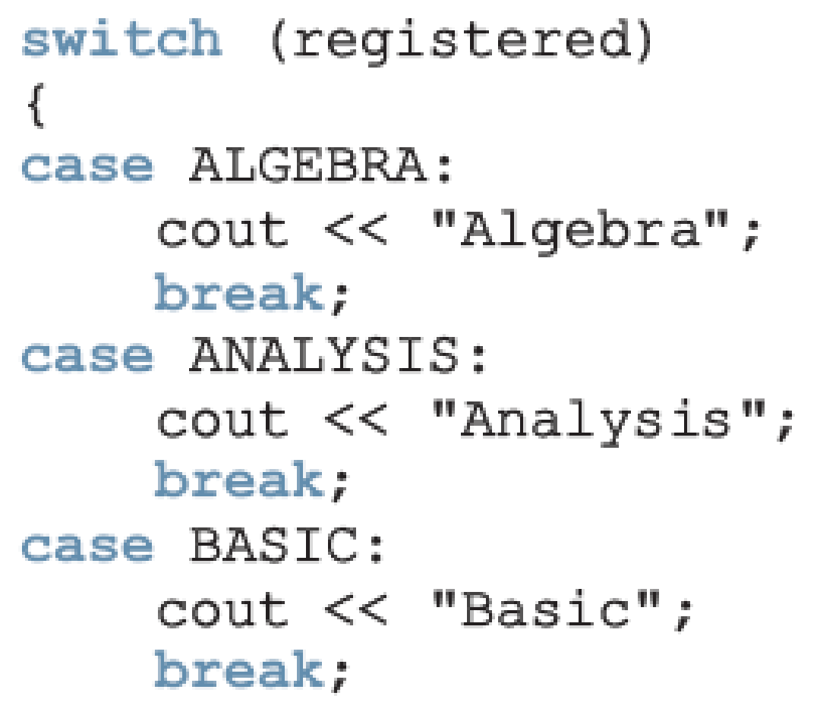
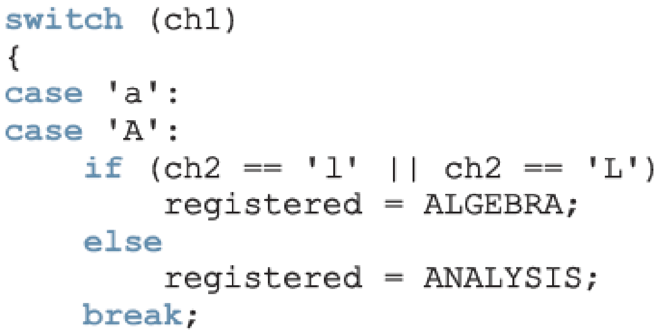
Input /Output of Enumeration Types
I/O are defined only for built-in data types
  Enumeration type cannot be input/output (directly)
C++ Programming: From Problem Analysis to Program Design, Fourth Edition
‹#›

Slide 13
Functions and Enumeration Types
Enumeration types can be passed as parameters to functions either by value or by reference
A function can return a value of the enumeration type
C++ Programming: From Problem Analysis to Program Design, Fourth Edition
‹#›

Slide 14
Declaring Variables When Defining the Enumeration Type
You can declare variables of an enumeration type when you define an enumeration type:
C++ Programming: From Problem Analysis to Program Design, Fourth Edition
‹#›

Slide 15
Anonymous Data Types
Anonymous type : values are directly specified in the declaration, with no type name
Drawbacks:
  Cannot pass/return an anonymous type to/from a function
  Values used in one type can be used in another, but are treated differently:
C++ Programming: From Problem Analysis to Program Design, Fourth Edition
‹#›

Slide 16

typedef Statement
You can create synonyms or aliases to a data type using the typedef statement
Syntax:
typedef does not create any new data types
  Creates an alias to an existing data type
C++ Programming: From Problem Analysis to Program Design, Fourth Edition
‹#›

Slide 17
Namespaces
ANSI/ISO standard C++ was officially approved in July 1998
Most of the recent compilers are also compatible with ANSI/ISO standard C++
For the most part, standard C++ and ANSI/ISO standard C++ are the same
  However, ANSI/ISO Standard C++ has some features not available in Standard C++
C++ Programming: From Problem Analysis to Program Design, Fourth Edition
‹#›

Slide 18
Namespaces (continued)
Global identifiers in a header file used in a program become global in the program
  Syntax error occurs if an identifier in a program has the same name as a global identifier in the header file
Same problem can occur with third-party libraries
  Common solution: third-party vendors begin their global identifiers with _ (underscore)
    Do not begin identifiers in your program with _
C++ Programming: From Problem Analysis to Program Design, Fourth Edition
‹#›

Slide 19
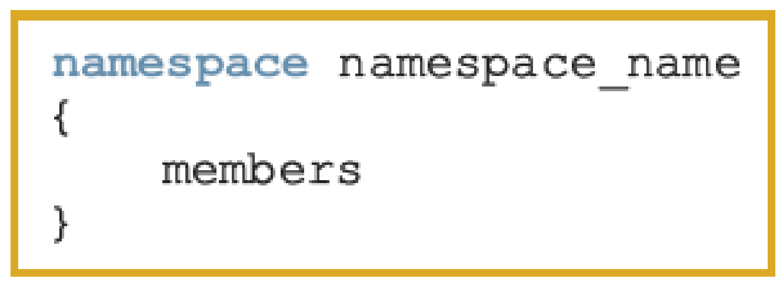
Namespaces (continued)
ANSI/ISO Standard C++ attempts to solve this problem with the namespace mechanism
Syntax:
where a member is usually a variable declaration, a named constant, a function, or another namespace
C++ Programming: From Problem Analysis to Program Design, Fourth Edition
‹#›

Slide 20
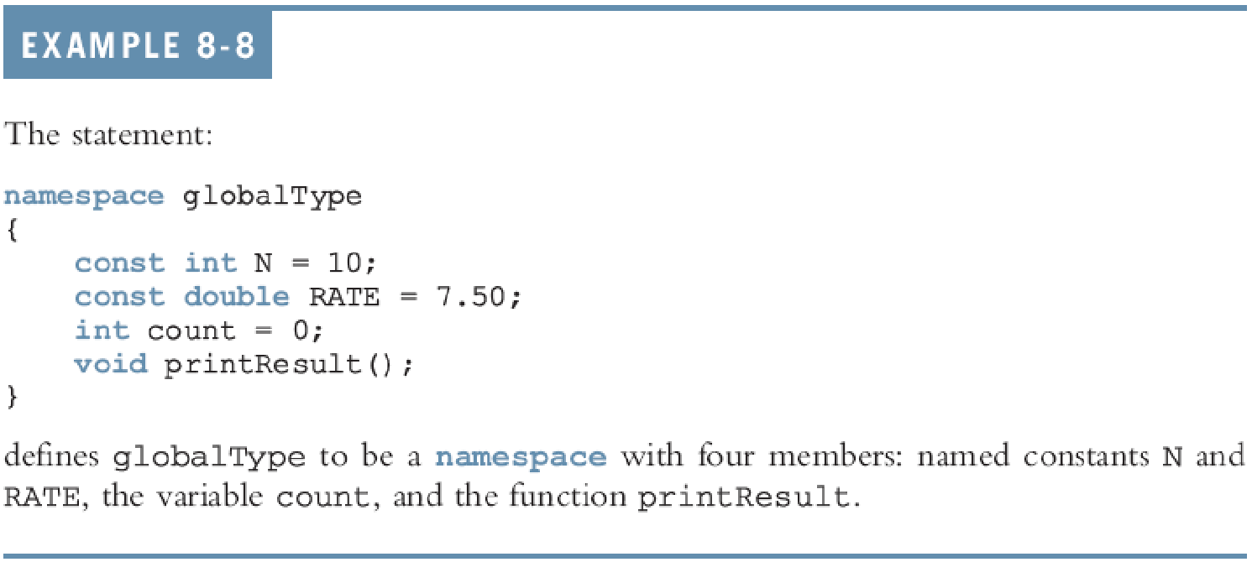
Namespaces (continued)
C++ Programming: From Problem Analysis to Program Design, Fourth Edition
‹#›

Slide 21



Namespaces (continued)
The scope of a namespace member is local to the namespace
Ways a namespace member can be accessed outside the namespace:
C++ Programming: From Problem Analysis to Program Design, Fourth Edition
‹#›

Slide 22
Accessing a namespace Member
Examples:
globalType::RATE
globalType::printResult();
After the using statement, it is not necessary to precede the namespace_name:: before the namespace member
  Unless a namespace member and a global identifier or a block identifier have same name
C++ Programming: From Problem Analysis to Program Design, Fourth Edition
‹#›

Slide 23
Summary
Enumeration type: set of ordered values
  Created with reserved word enum creates an enumeration type
No arithmetic operations are allowed on the enumeration type
Relational operators can be used with enum values
Enumeration type values cannot be input or output directly
C++ Programming: From Problem Analysis to Program Design, Fourth Edition
‹#›

Slide 24
Summary (continued)
Anonymous type: a variable’s values are specified without any type name
Reserved word typedef creates synonyms or aliases to previously defined data types
The namespace mechanism is a feature of ANSI/ISO Standard C++
A namespace member is usually a named constant, variable, function, or another namespace
C++ Programming: From Problem Analysis to Program Design, Fourth Edition
‹#›

Slide 25
Summary (continued)
Keyword namespace must appear in the using statement
A string is a sequence of zero or more characters
Strings in C++ are enclosed in ""
In C++, [] is the array subscript operator
The function length returns the number of characters currently in the string
C++ Programming: From Problem Analysis to Program Design, Fourth Edition
‹#›

Slide 26
Summary (continued)
The function size returns the number of characters currently in the string
The function find searches a string to locate the first occurrence of a particular substring
The function substr returns a particular substring of a string
The function swap is used to swap the contents of two string variables
C++ Programming: From Problem Analysis to Program Design, Fourth Edition
‹#›

